Slide 1

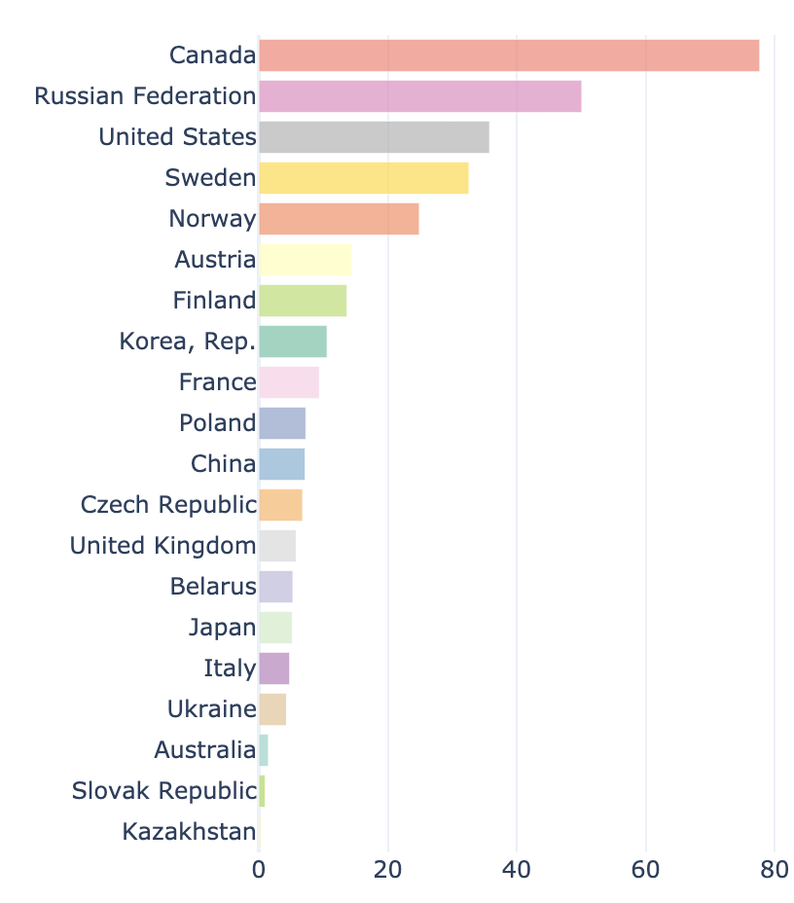
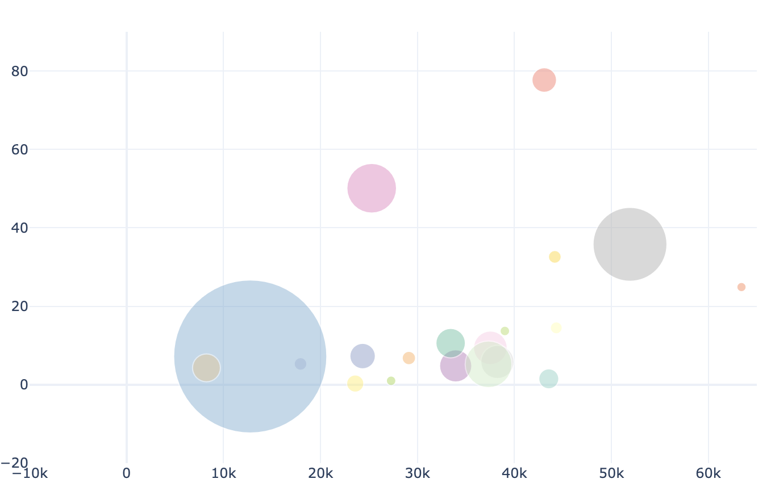
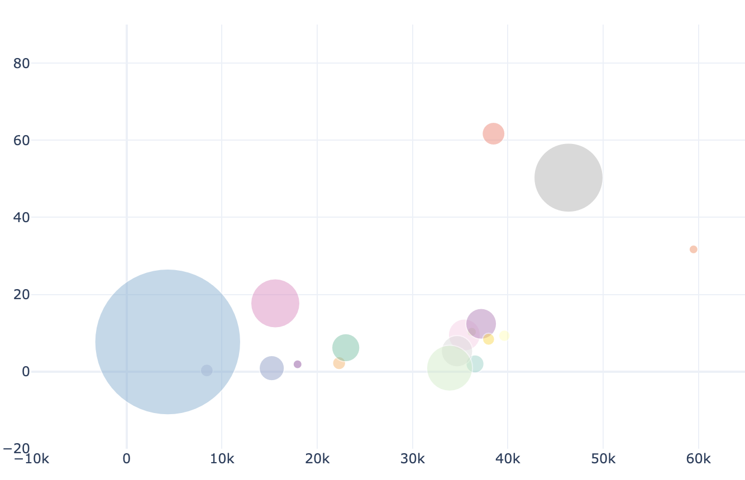
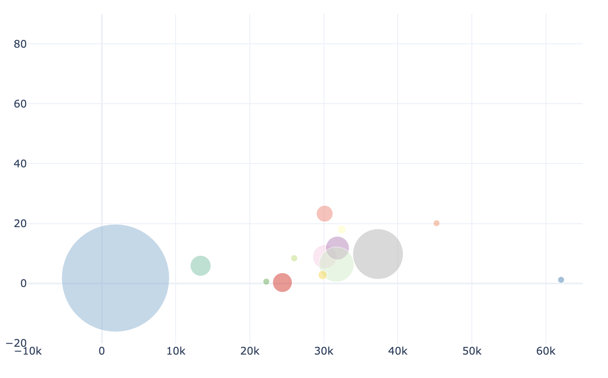
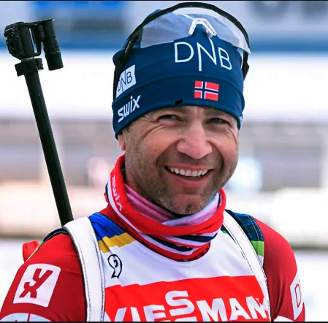
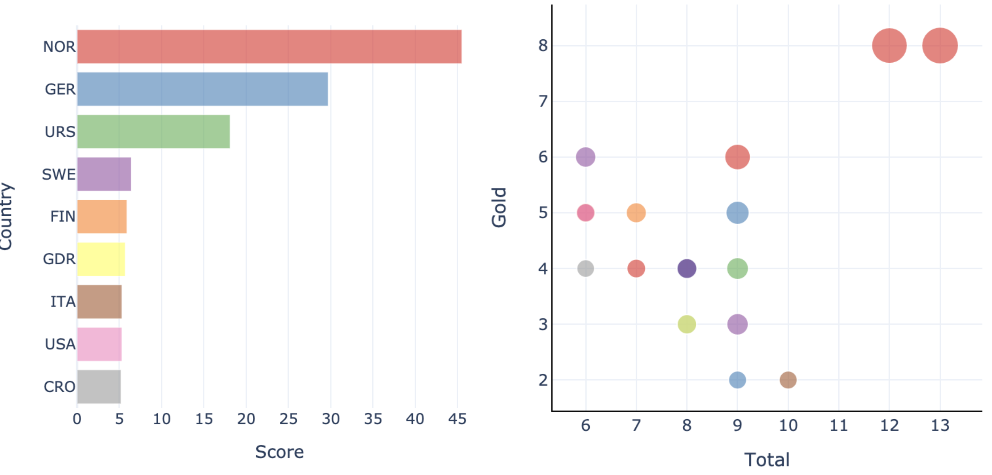
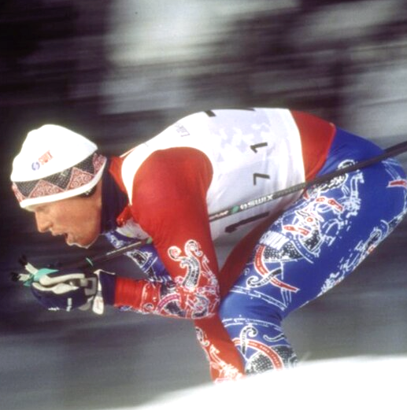
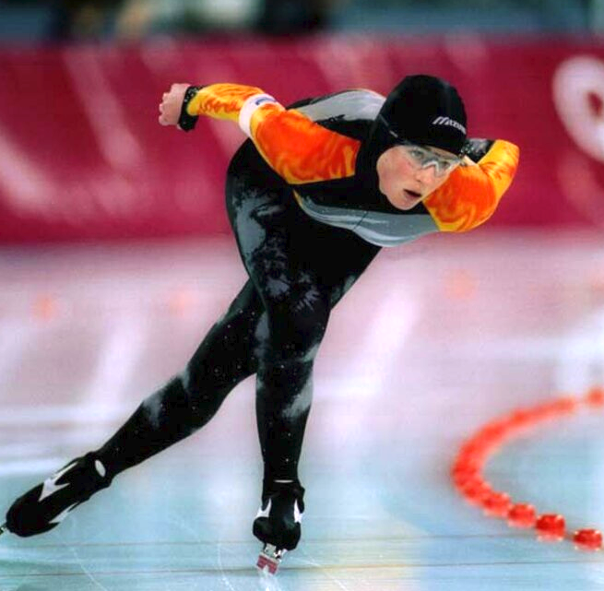
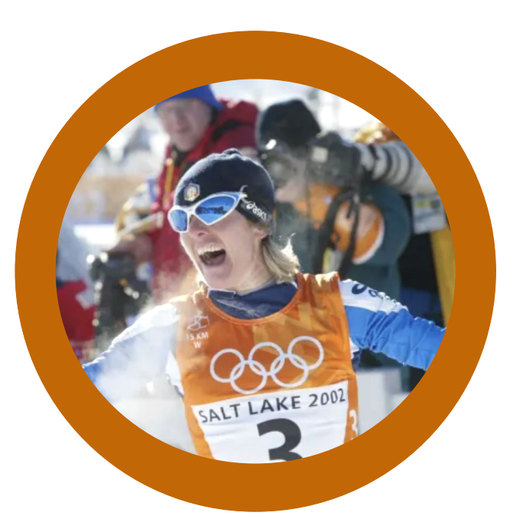

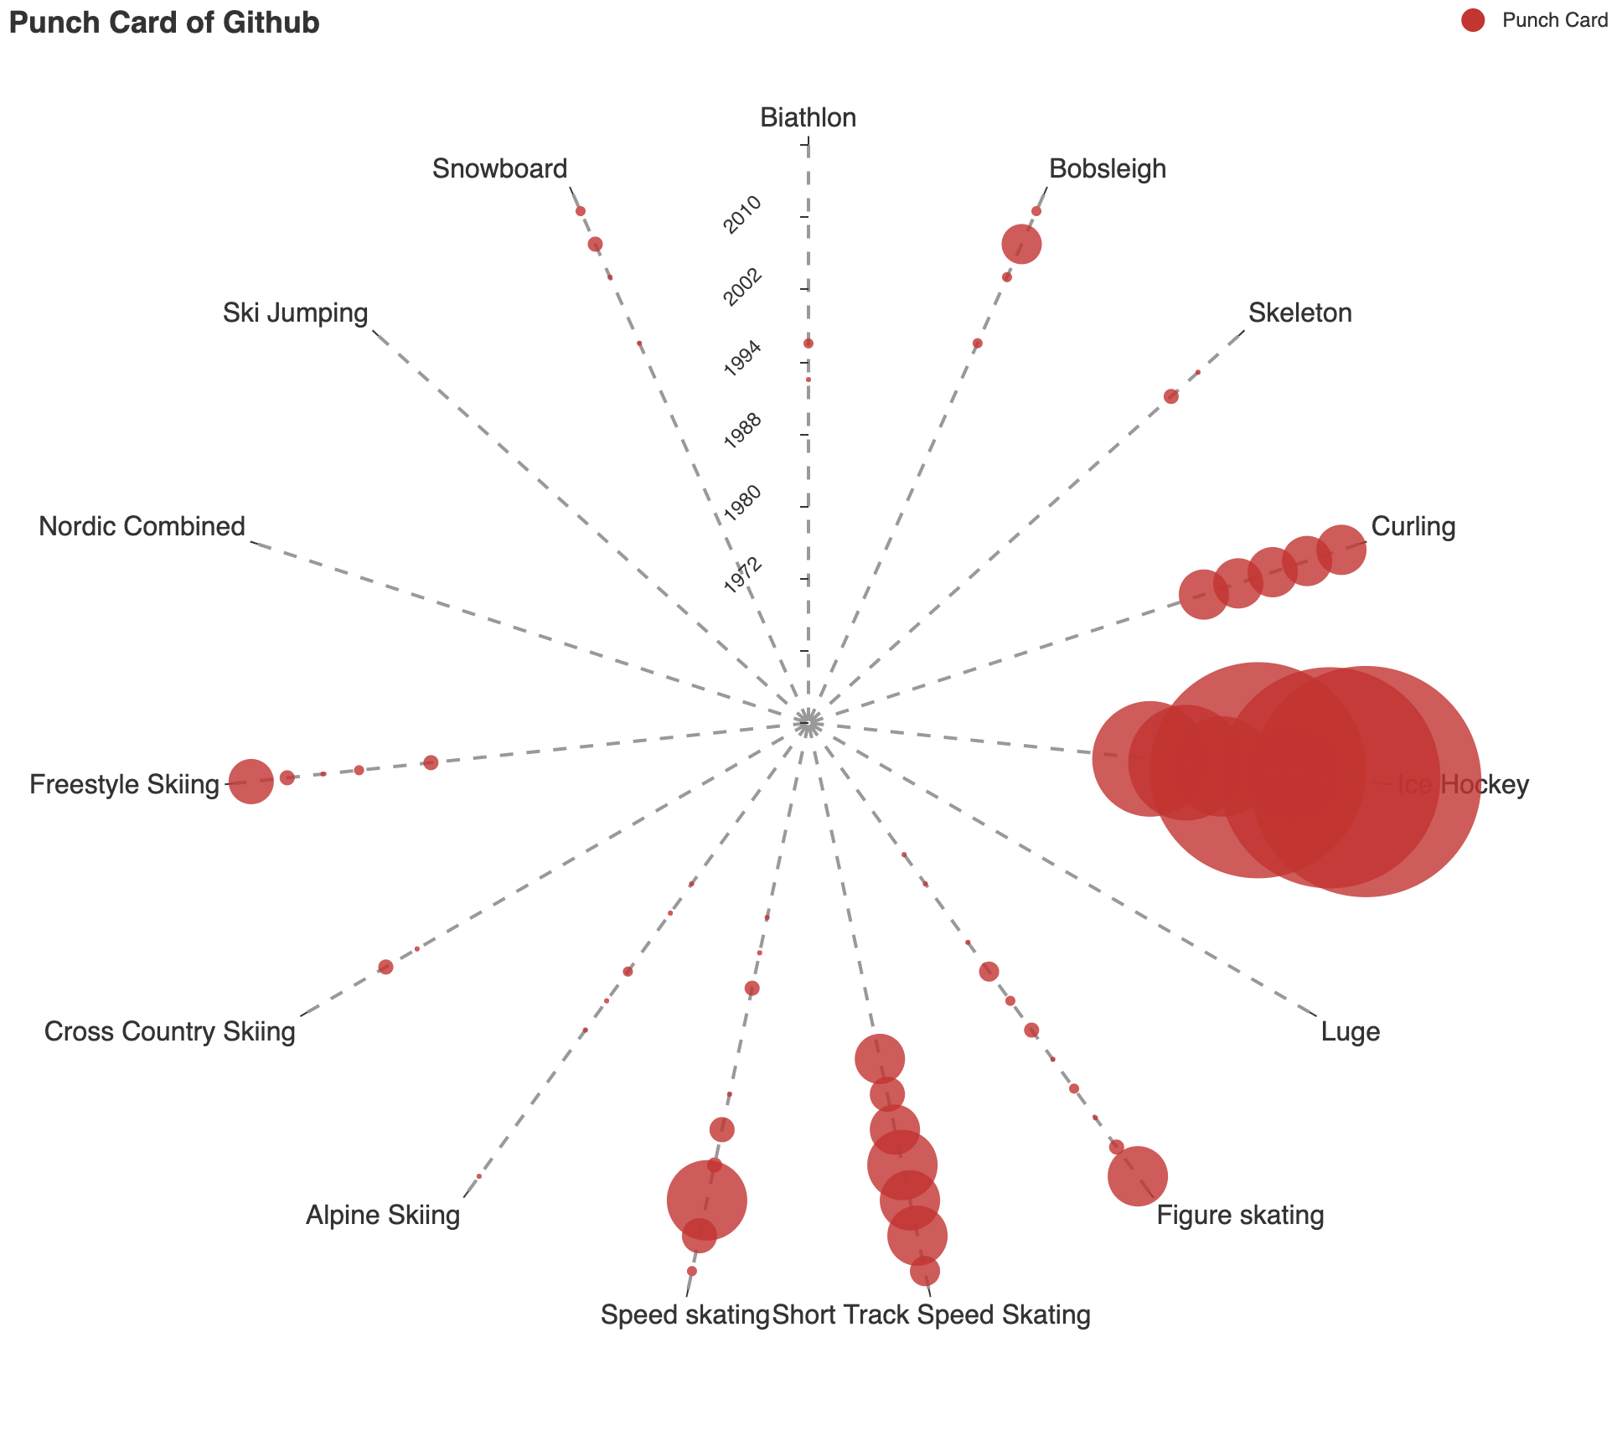
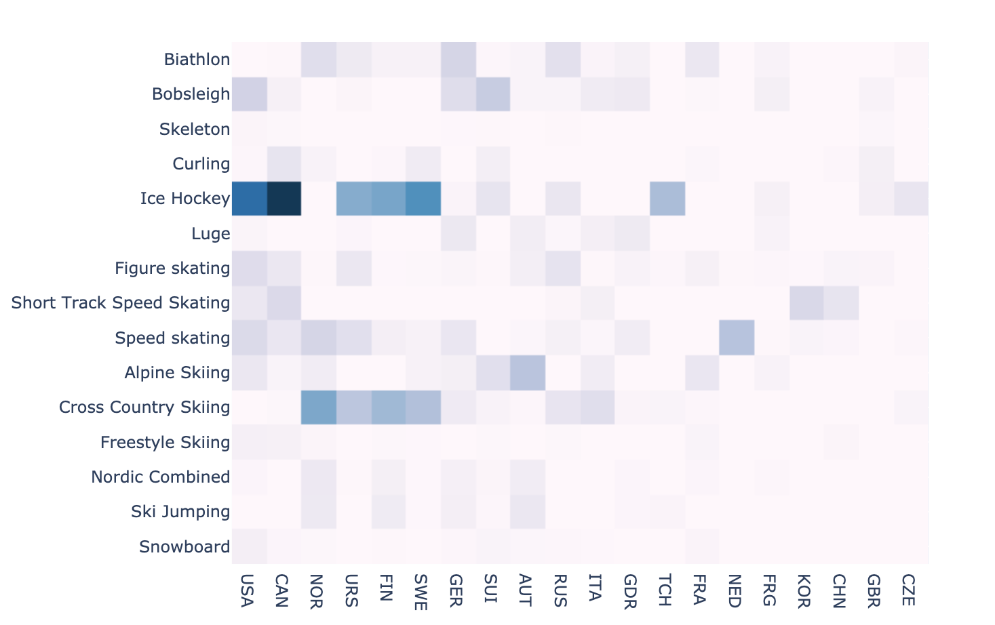
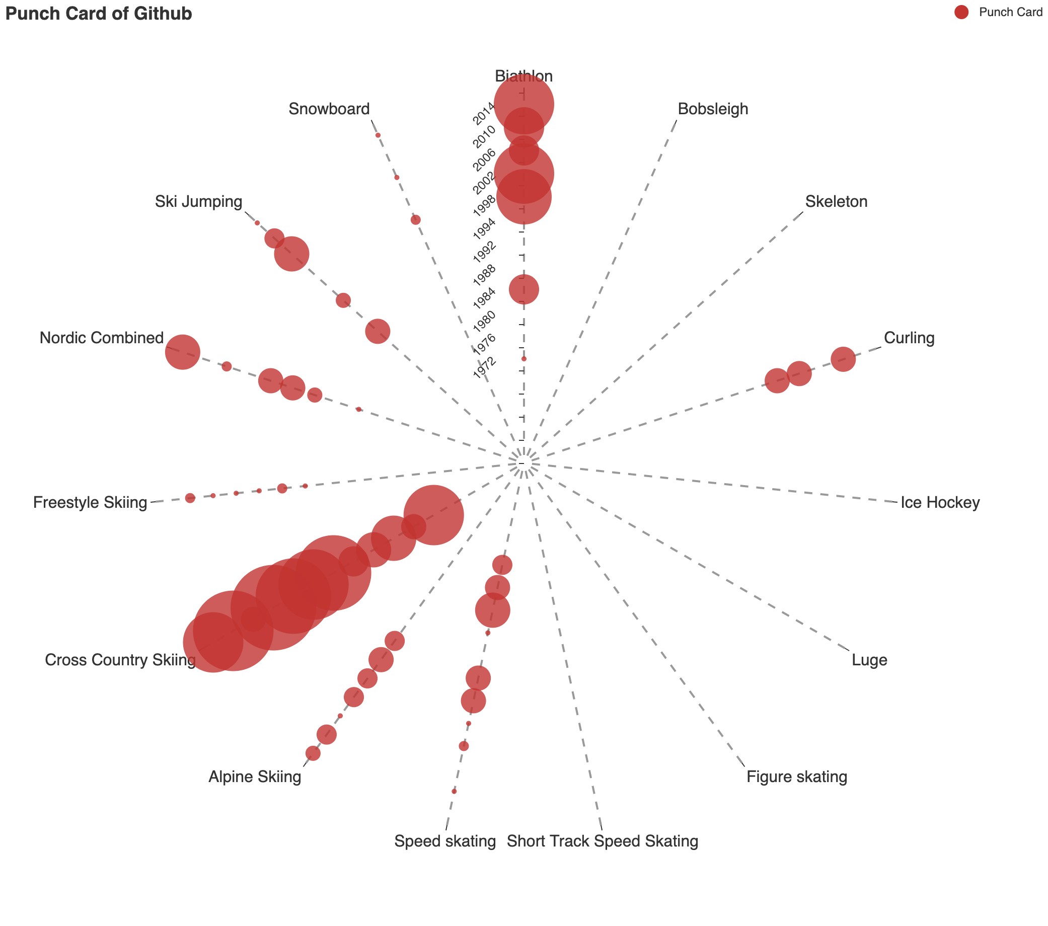
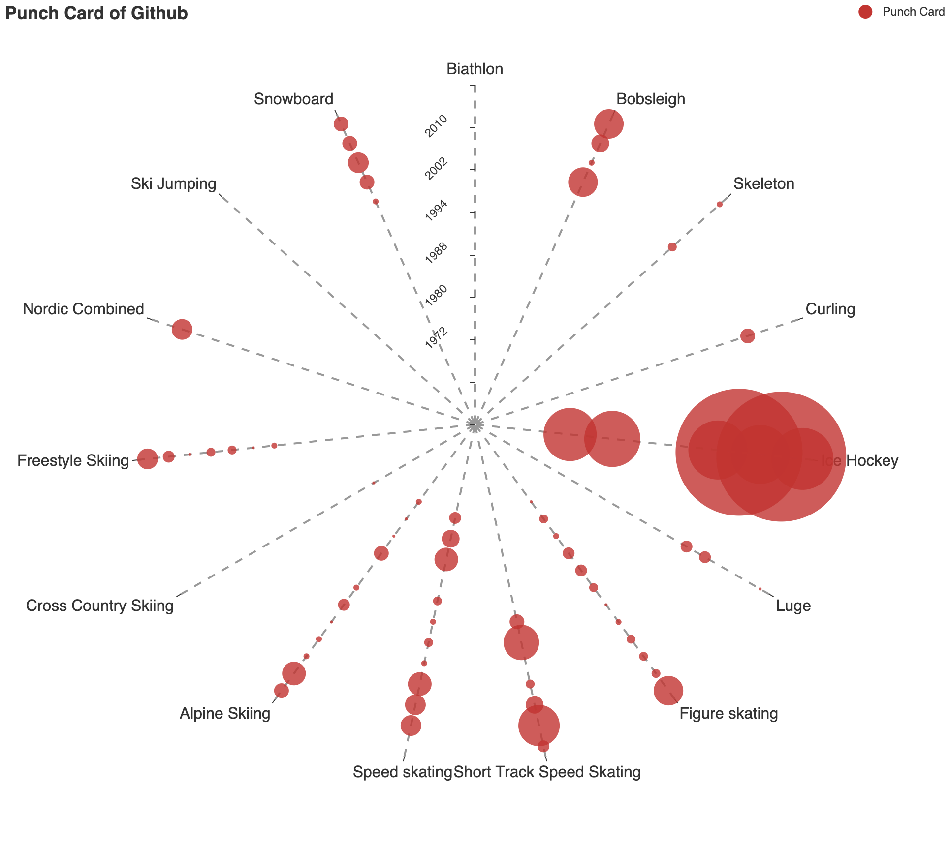
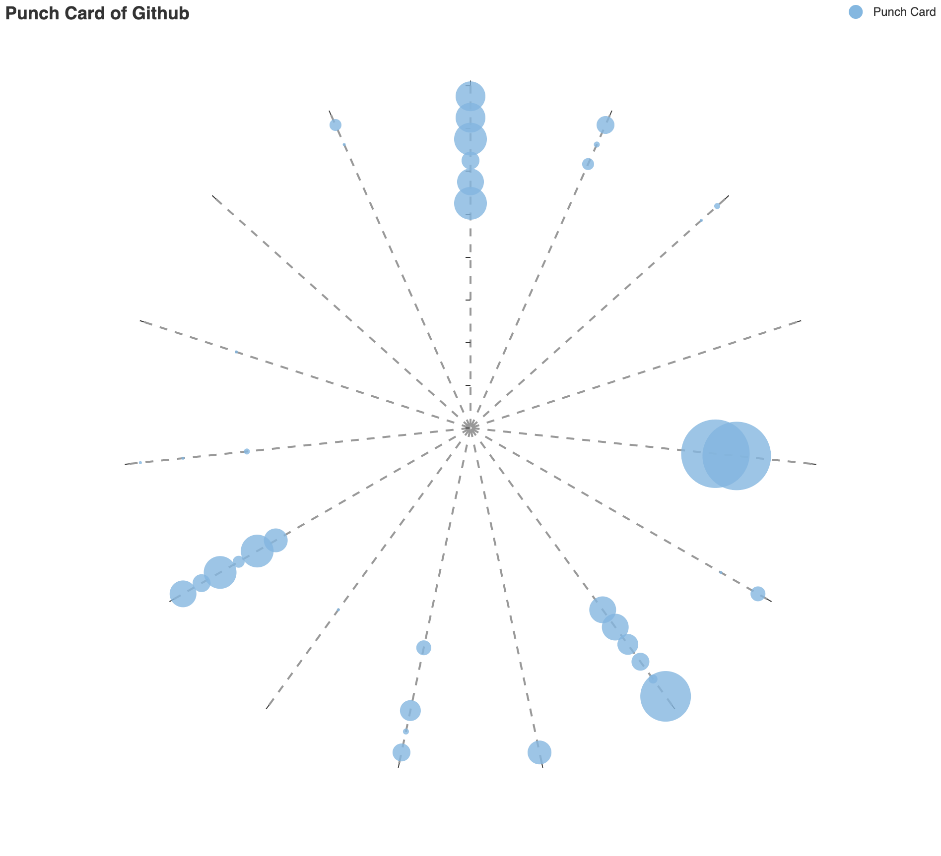
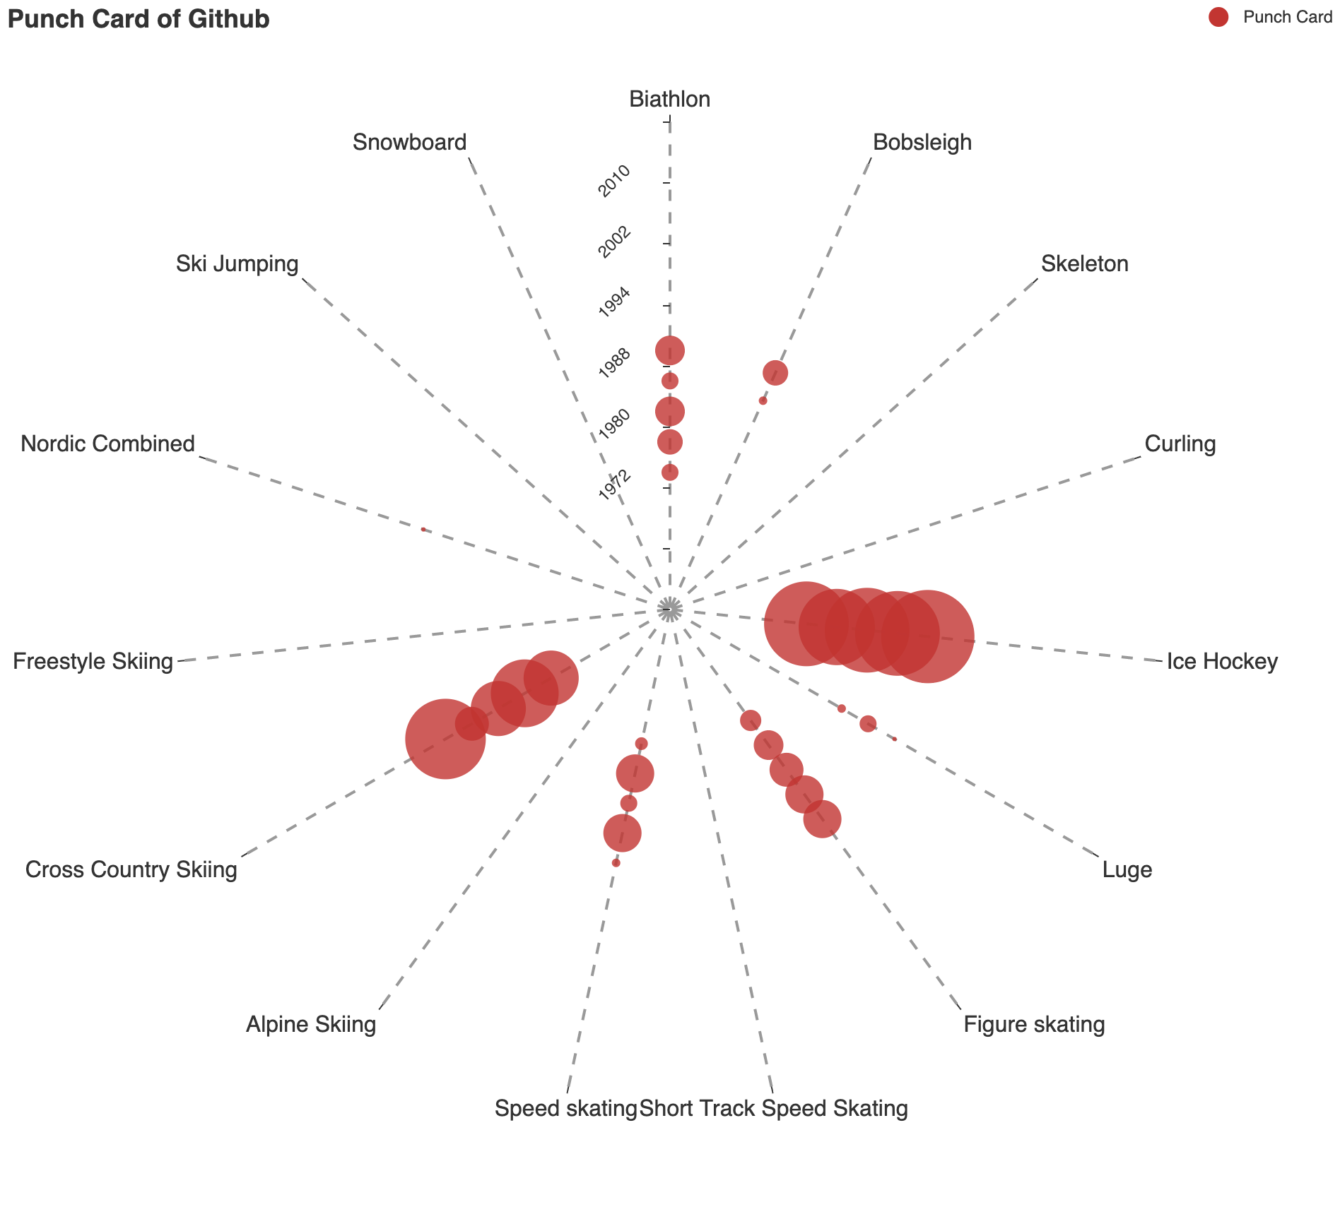
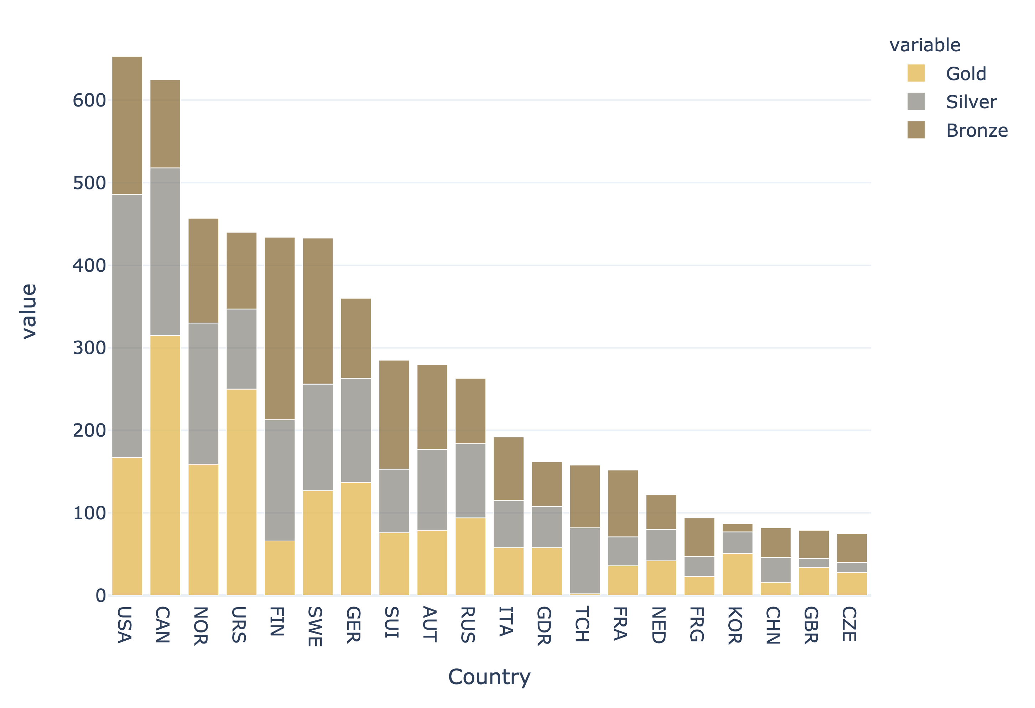

Who’s the Winner
of Winter Olympics and … Why?
An analysis of
winter Olympics Data
Country and Athletes
1972 – 2014
Created by
Rima Yining Cao
Who wins more medals ?
Wealthier Country performs better ?
Who has most decorated athletes?
Medals & GDPs
2014
2002
1994
NO.2
NO.1
Medal Score
NO.3
GDP Per Capita
GDP Per Capita
In 2002, Canada, United States and Norway performed far better than other countries.
Back to 1994, less medals are wined for all countries. However, the positive correlation remains.
GDP Per Capita
How is Medal score calculated?
1
In the graph, we show the relationship between medal score, GDP per capita and total population of a country (with the size of circle represent the population) over time.
Bjoerndalen, Ole Einar
1 Silver = 0.6 Gold
In terms of the medal score, Canada is the no.1 winner in all three years.
.3
8 Gold, 13 Medal
1 Bronze= 0.3 Gold
0
.6
1
Country: Norway Born: 27 Jan 1974
Discipline: Cross Country Skiing
Biathlon
Olympic Year: 1994 - 2014
Medal Score =
Gold + 0.6Silver + 0.3Bronze
We can also see an obvious positive correlation between wealth and winter Olympic performance
Medal Score
The two athletes Bjoerndalen and Daehlie are far ahead than other athletes
Daehlie, Bjorn
Winner by Athletes
8 Gold, 12 Medal
Country rank with total Athlete Score
Country: Norway Born: 19 Jun 1967
Discipline: Cross Country Skiing
Olympic Year: 1992 - 1998
Countries can be recognized with some extraordinary athletes.
Norway
Germany
Daehlie, Bjorn
Norway is the country with the most (both in quality and quantity) decorated athletes, followed by German and Soviet Union.
Soviet Union
8 Gold, 12 Medal
Number of Gold
Country: Norway Born: 19 Jun 1967
Discipline: Cross Country Skiing
Olympic Year: 1992 - 1998
Sweden
Finland
The results are calculated with data from 1924 –2014 and we only choose top 25 athletes for calculation.
How is Medal score calculated?
East German
Number of Total
Belmondo, Stefania
Athlete Score = Sum of all athlete in that country
Italy
Circle size:
Athlete Score
2 Gold, 10 Medal
United States
1
Athlete Score =
Gold + 0.6Silver + 0.3Bronze
Country: Norway Born: 13 Jan 1969
Discipline: Cross Country Skiing
Olympic Year: 1988 - 2002
45
40
35
30
25
20
15
10
Croatia
.3
5
0
Athlete Score
0
.6
Winner by Sports
1
How to read the graph?
Canada
The radius axis represents the time dimension, from 1972-2014. The angle axis represent 15 different sports in winter Olympics. The circle size encodes the total number of medals
Norway
Who is Good at What?
Countries’ skilled sports over time (1972 - 2014)
Ice Hockey and Cross-Country Skiing are two most popular sports with most medals wined
We can see both these 4 countries win more medals over year.
United States
Norway is good at Biathlon and Cross-Country Skiing, while Canada and the United States are both skilled at Ice-Hockey. Most of their medals are wined by this sport.
Number of Medals
from 1924 - 2014
0
Russian
200
Gold
The data for Russian is counted based on Soviet Union before 1988 and on Russian Empire afterwards
Russian is more balanced in each sport with a better performance on Ice-Hockey.
400
United States wins the most medals over all
Silver
600
Bronze

Slide 2
Who’s the Winner
of Winter Olympics and … Why?

